Slide 1
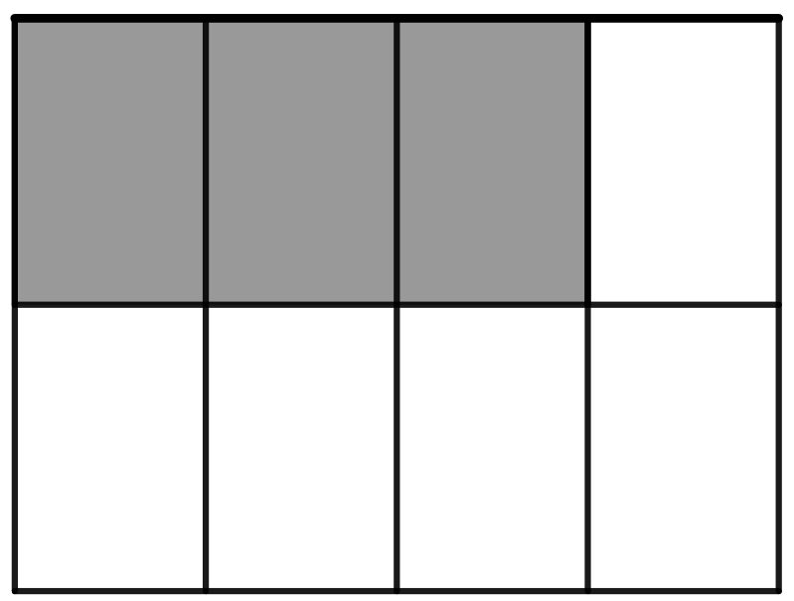
Part-whole item
What fraction of the whole rectangle is shaded?

Slide 2
What fraction of the smiley faces below are shaded?

Slide 3
Quotient item
Three friends are sharing two chocolate bars. How could they split
the bars so that each friend gets the same amount of chocolate?
How many bars worth of chocolate does each friend get?

Slide 4
Mark where ¾ is on the number line below.
0
¼

Slide 5
Jamie usually makes punch by mixing 2 cups of orange juice with
3 cups of pineapple juice. This time, she wants it to have a stronger orange flavor. Which of the following ratios of orange juice to
pineapple juice could she use?
A) 4:6 B) 2:4 C) 4:3

Slide 6
At the end of Britney’s birthday party, ¼ of the cake was left over.
The next day, Britney and two friends evenly shared the left-over
cake. What fraction of the original cake did each person get?

Slide 7
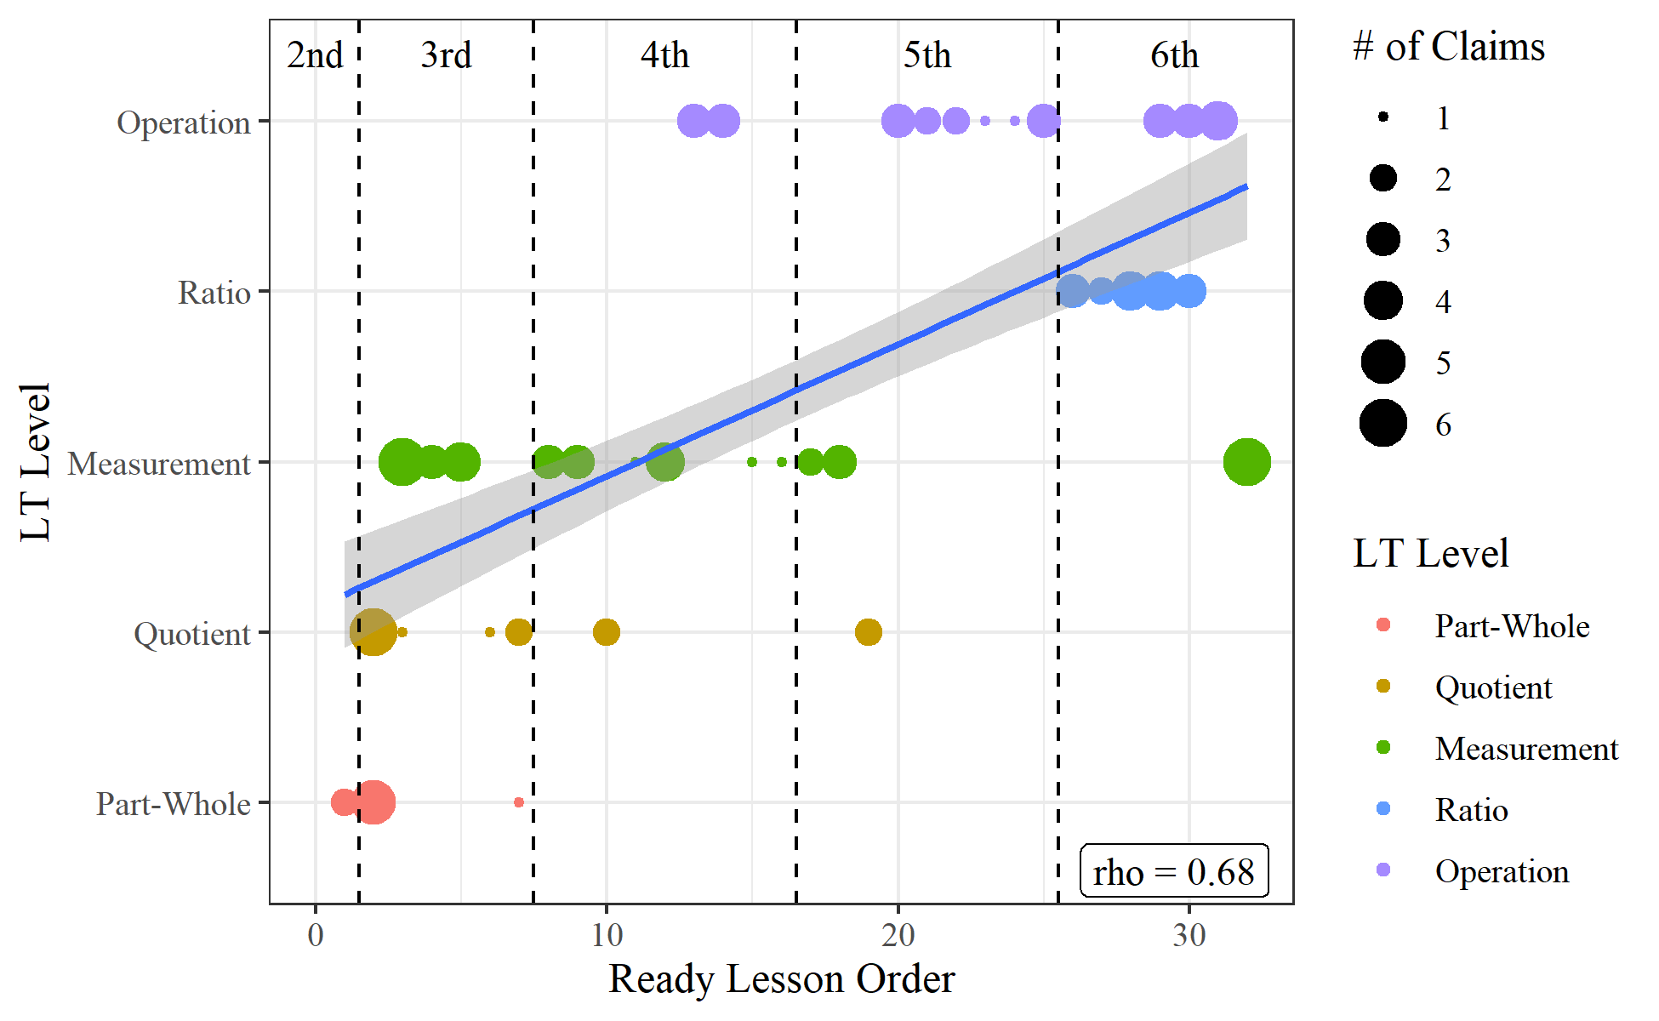

Slide 8
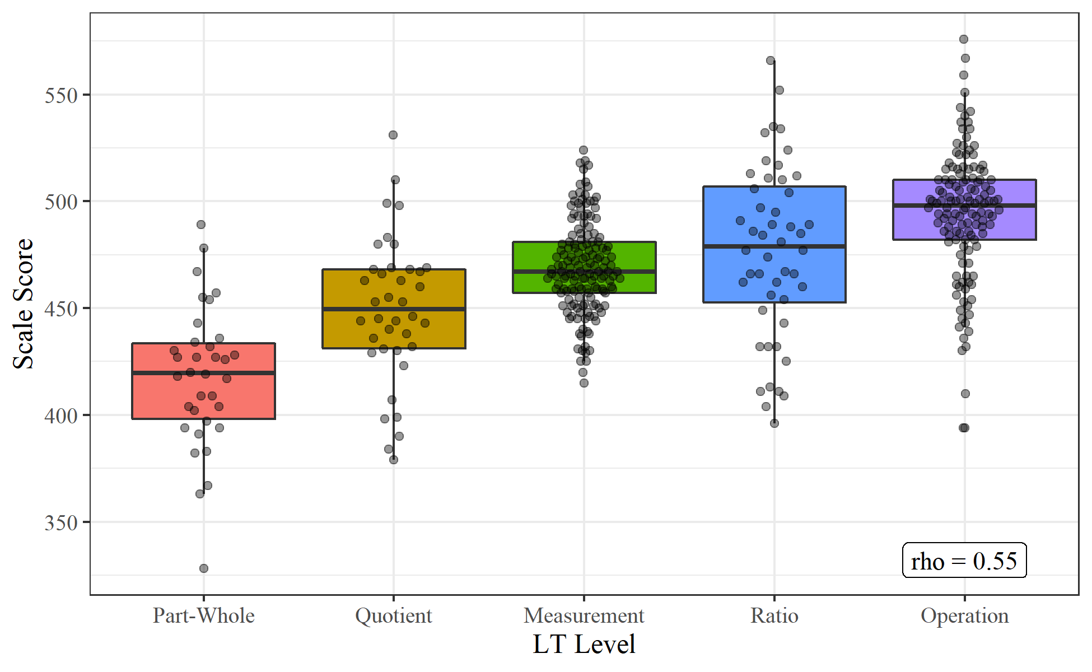

Slide 9
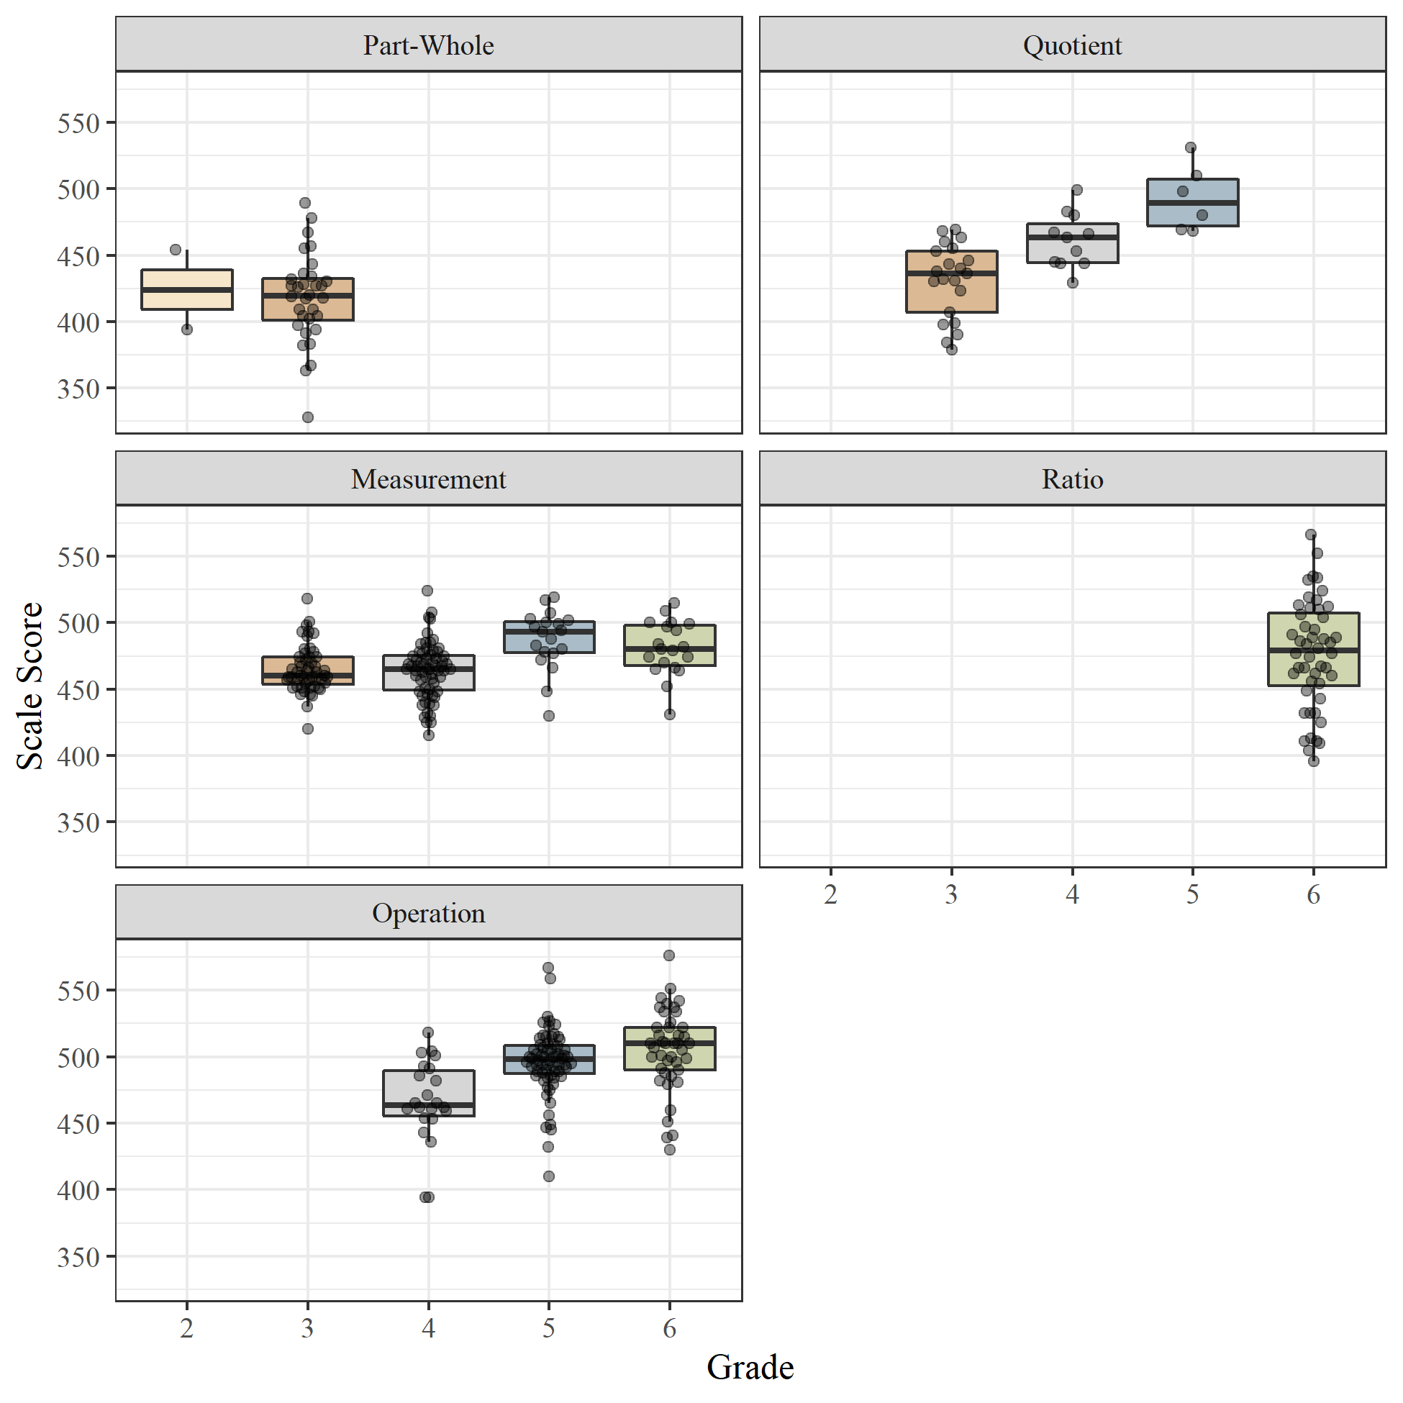

Slide 10
Prompt: Split eight counters evenly between four people.
Incorrect Number of Groups
Unequal Groups
Not Exhausting the Set

